Slide 1
Password Cracking Tools

Slide 2
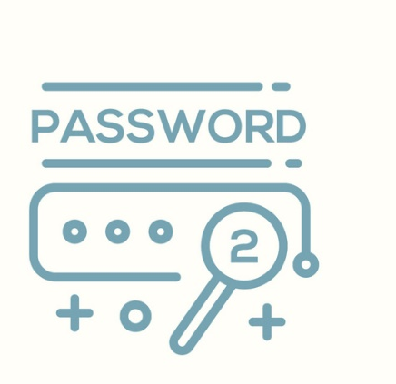
Password Crackers
Passwords are stored as hashes
Grab copy of the hashes, crack offline
Use known, common passwords from a wordlist
Use rainbow tables
Pre-calculated hashes, based on system (SQL, Linux, Windows)
Password salting can combat rainbow tables
Security professionals audit user passwords using same tools as hackers would
Find and fix problem before it can be exploited

Slide 3
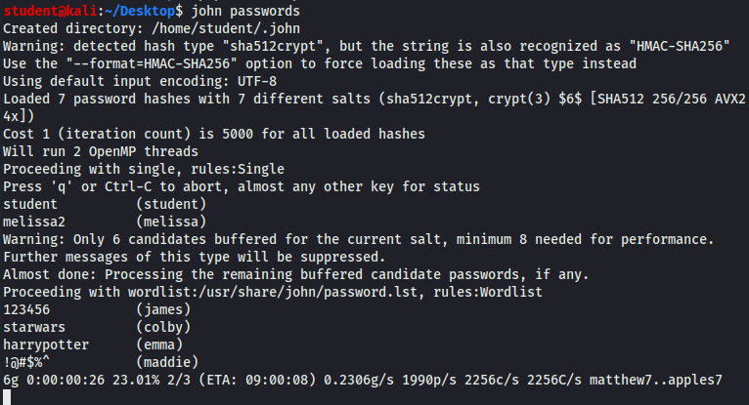
Example - JtR
John the Ripper
Multiple step process
Rules, Dictionary, and Brute Force
Using JtR to audit passwords

Slide 4
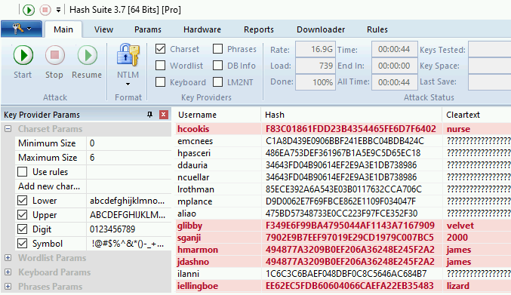
Example - Hash Suite
Runs on Windows and Android OS
Different processes allowed
Screenshot of password auditing with Hash Suite

Slide 5
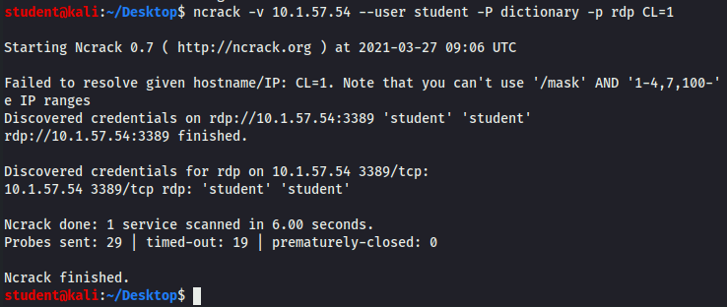
Example - ncrack
Attempts to crack network authentications
Typically, not used with captured hashes
Screenshot of password auditing a remote desktop system using ncrack

Slide 6
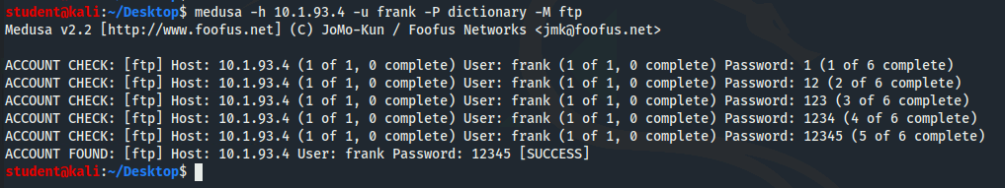
Example - medusa
Attempts to crack network authentications
Typically, not used with captured hashes
Screenshot of password auditing a remote ftp server using medusa

